Slide 3
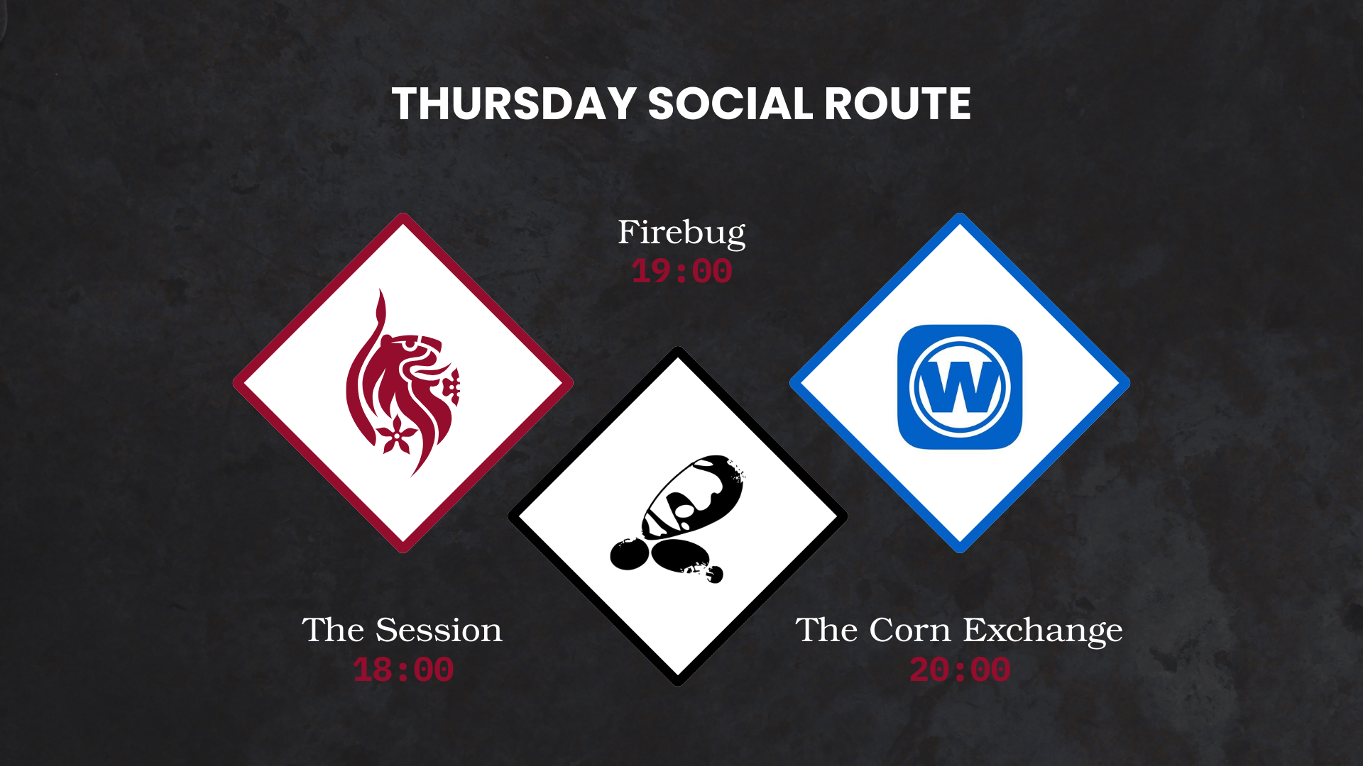

Slide 4


DMU
Hacking Society
5 Minute Talks

Slide 5



DMU HACKERS
D0nt d0 1ll3gal sh1t
please..

Slide 6
Announcements
DMU HACKERS
PwnEd qualifiers are this weekend - there is still time to sign up and join the C team
Q-Zips should be here next week!
P2P CTF sign-ups are now live on discord!
We have an alumni coming next week to give a talk on OSINT

Slide 7
Running Order
DMU HACKERS
Amara
Nikita
Charlie
Dennis
Josh
Ethan

